Slide 1
Computing Hardware – Past, Present, Future To See Far, Dive Deep
Lou Mazzucchelli
CSCI 0020 – October 2024

Slide 2
The IT Uber-stack
Applications
Middleware
Operating Systems
Computers
Processors | Memories | Display Components | Interconnects
Materials
Physics
Notes:
Middleware is anything that’s not an app or an OS ==> languages, databases, frameworks, etc.

Slide 3
Change Vectors
Applications
Middleware
Operating Systems
Computers
Processors
Memories
Display Components
Interconnects
Materials
Physics
Notes:
Middleware is anything that’s not an app or an OS ==> languages, databases, frameworks, etc.

Slide 4
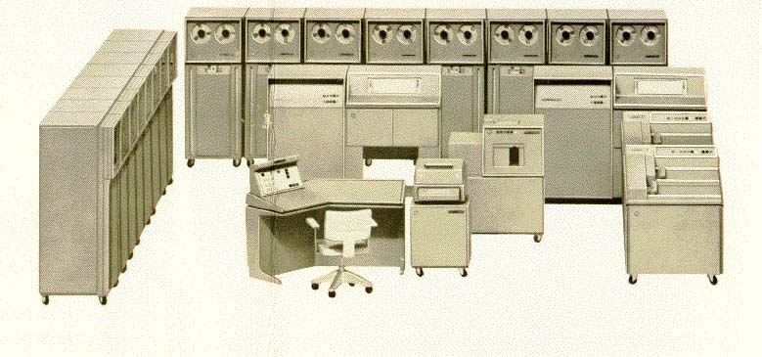
Top-down example
Burroughs B5000 - 1961
Notes:
DAT drove a change in processor design to support VM, but did not drive a change in circuit design

Slide 5
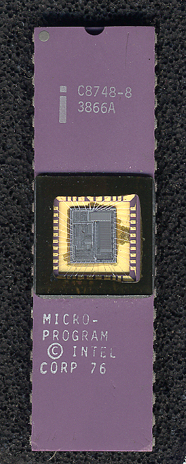
Bottom-up example
Notes:
Single-ship, reprogrammable devices enabled completely new products to be imagined

Slide 6
Technology Forecasting Heuristics - 1
Look downstream in the supply chain: To see what <HP> might do tomorrow, watch what <Intel> does today.
Notes:
Look downstream in the supply chain

Slide 7
Technology Forecasting Heuristics - 2
If no disruptive change in materials or physics, Look to a previous generation: To know what <Intel> might do tomorrow, know what <IBM> did 20 years ago.
Notes:
Riding Moores Law is not a disruptive change
Look backwards in time to a previous incarnation

Slide 8
The Wheel of Reincarnation
Applications
Middleware
Operating Systems
Computers
Processors | Memories | Display Components | Interconnects
Materials
Physics
Notes:
Fed from developments in lowest and highest levels
Even if you don’t remember the past, you are condemned to repeat it…
What is the cycle time?

Slide 9
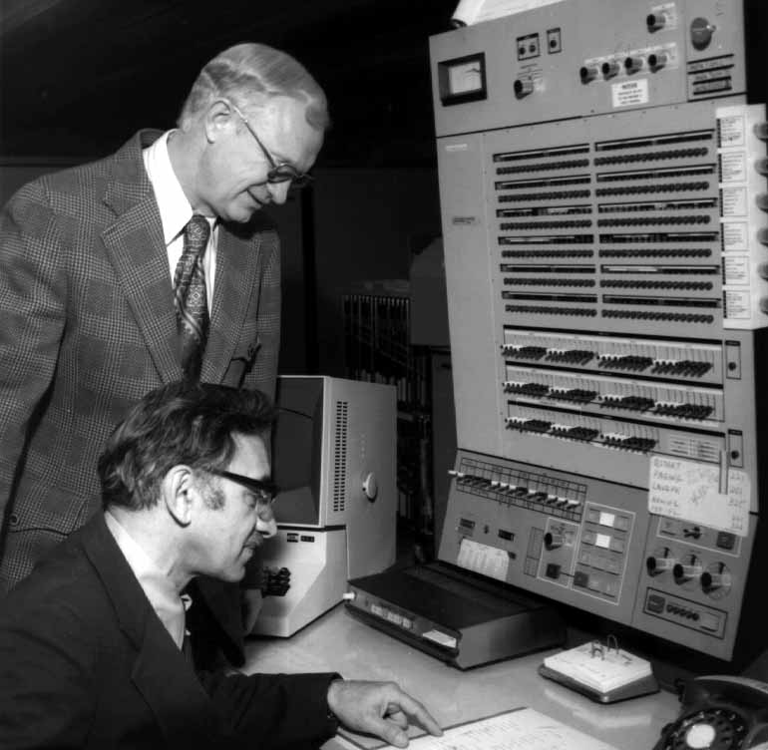
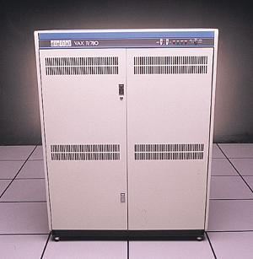
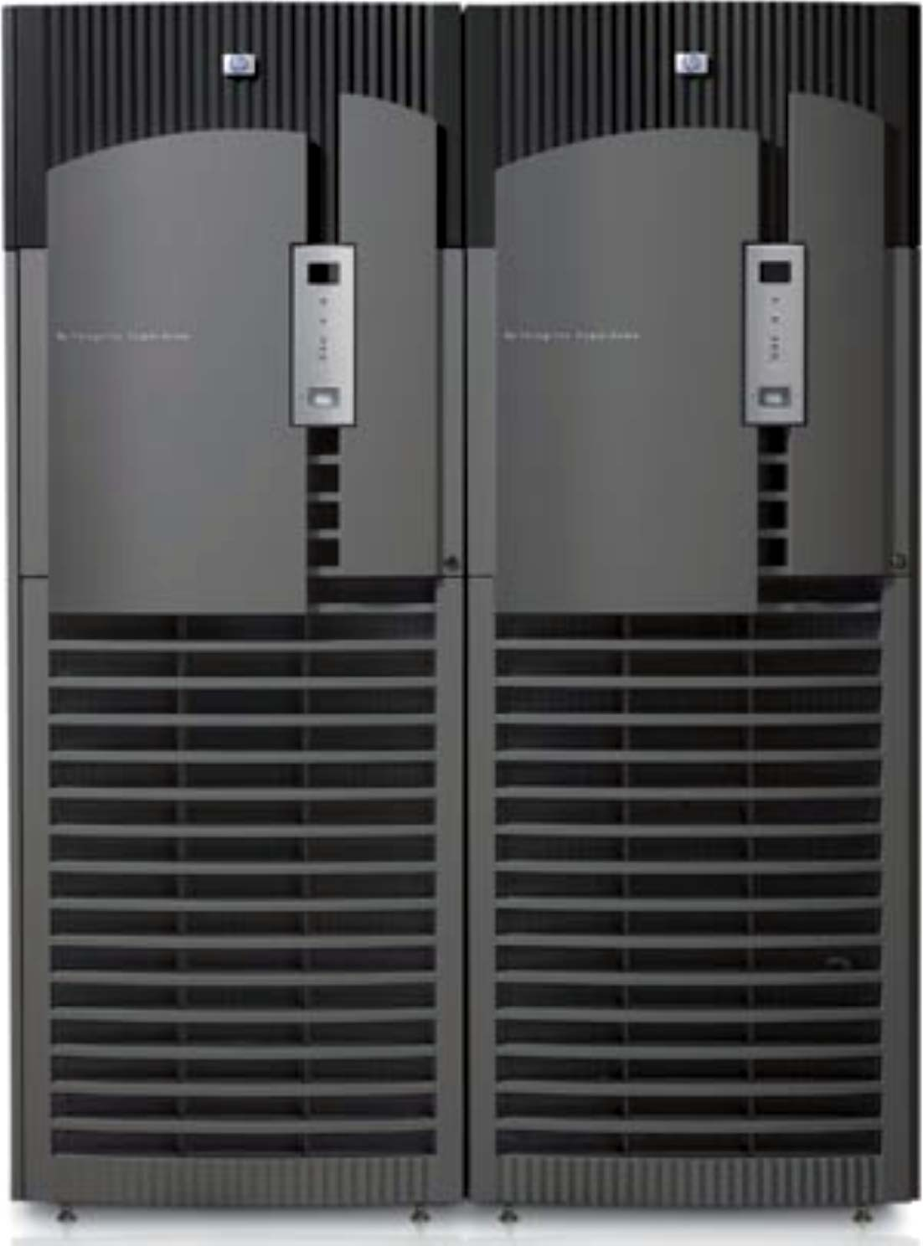
The Wheel of Reincarnation
1960-1980
1980-2000
2000 - 2020
Is there a pattern here?
Notes:
Turns in about a 20-year cycle

Slide 10
Technology Forecasting Heuristics - 3
If change in materials, Understand economics of migrating change to systems manufacturing
Notes:
Analyze costs and benefits, addressing unmet or partially met higher-level requirements
GaAs, SOS couldn’t make the mainstream cut

Slide 11
Technology Forecasting Heuristics - 4
If change in physics, Understand economics of migrating change to materials manufacturing
Notes:
Costs and benefits, addressing unmet or partially met higher-level requirements
Quantum computing is an interesting idea, but no cheap qubit storage and retrieval yet

Slide 12
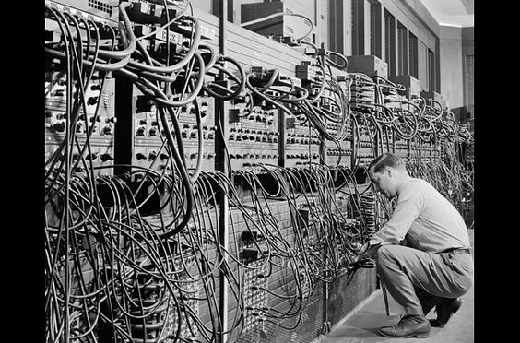
Pre-history (bespoke computers)
ENIAC - 1946
Notes:
Electronic numerical integrator and calculator – Univ of Pennsylvania
17,000 vacuum tubes, 70,000 resistors, and 10,000 capacitors
50-by-30-foot basement space
5000 additions per second

Slide 13
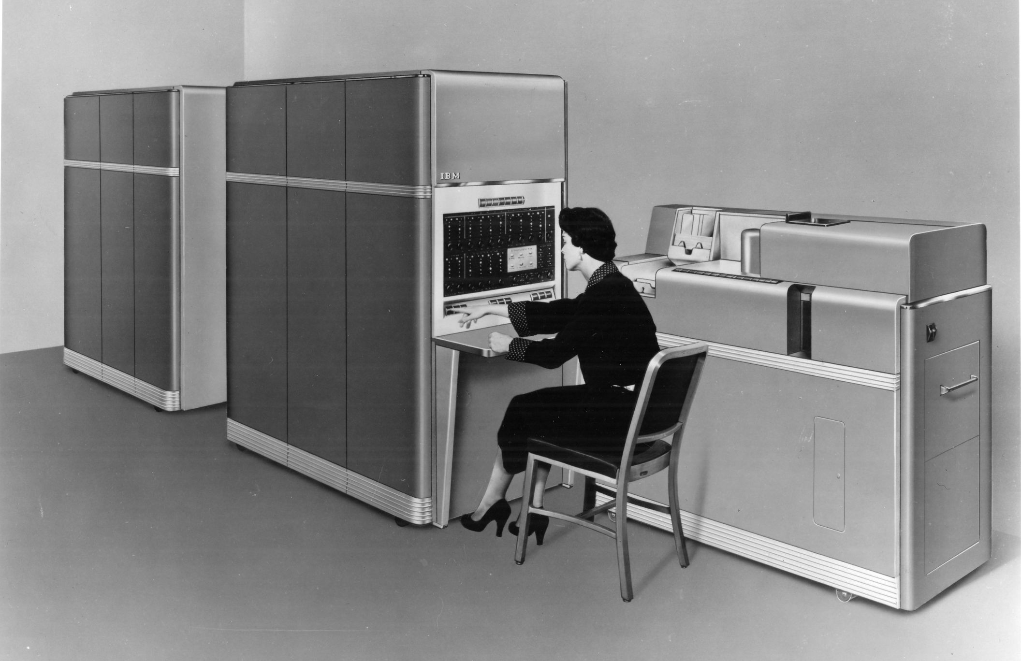
Mainframe Computing
IBM 650 - 1953
- 40 ips
- $150K ($1.8M in 2024 dollars)
- 2,000 produced

Slide 14
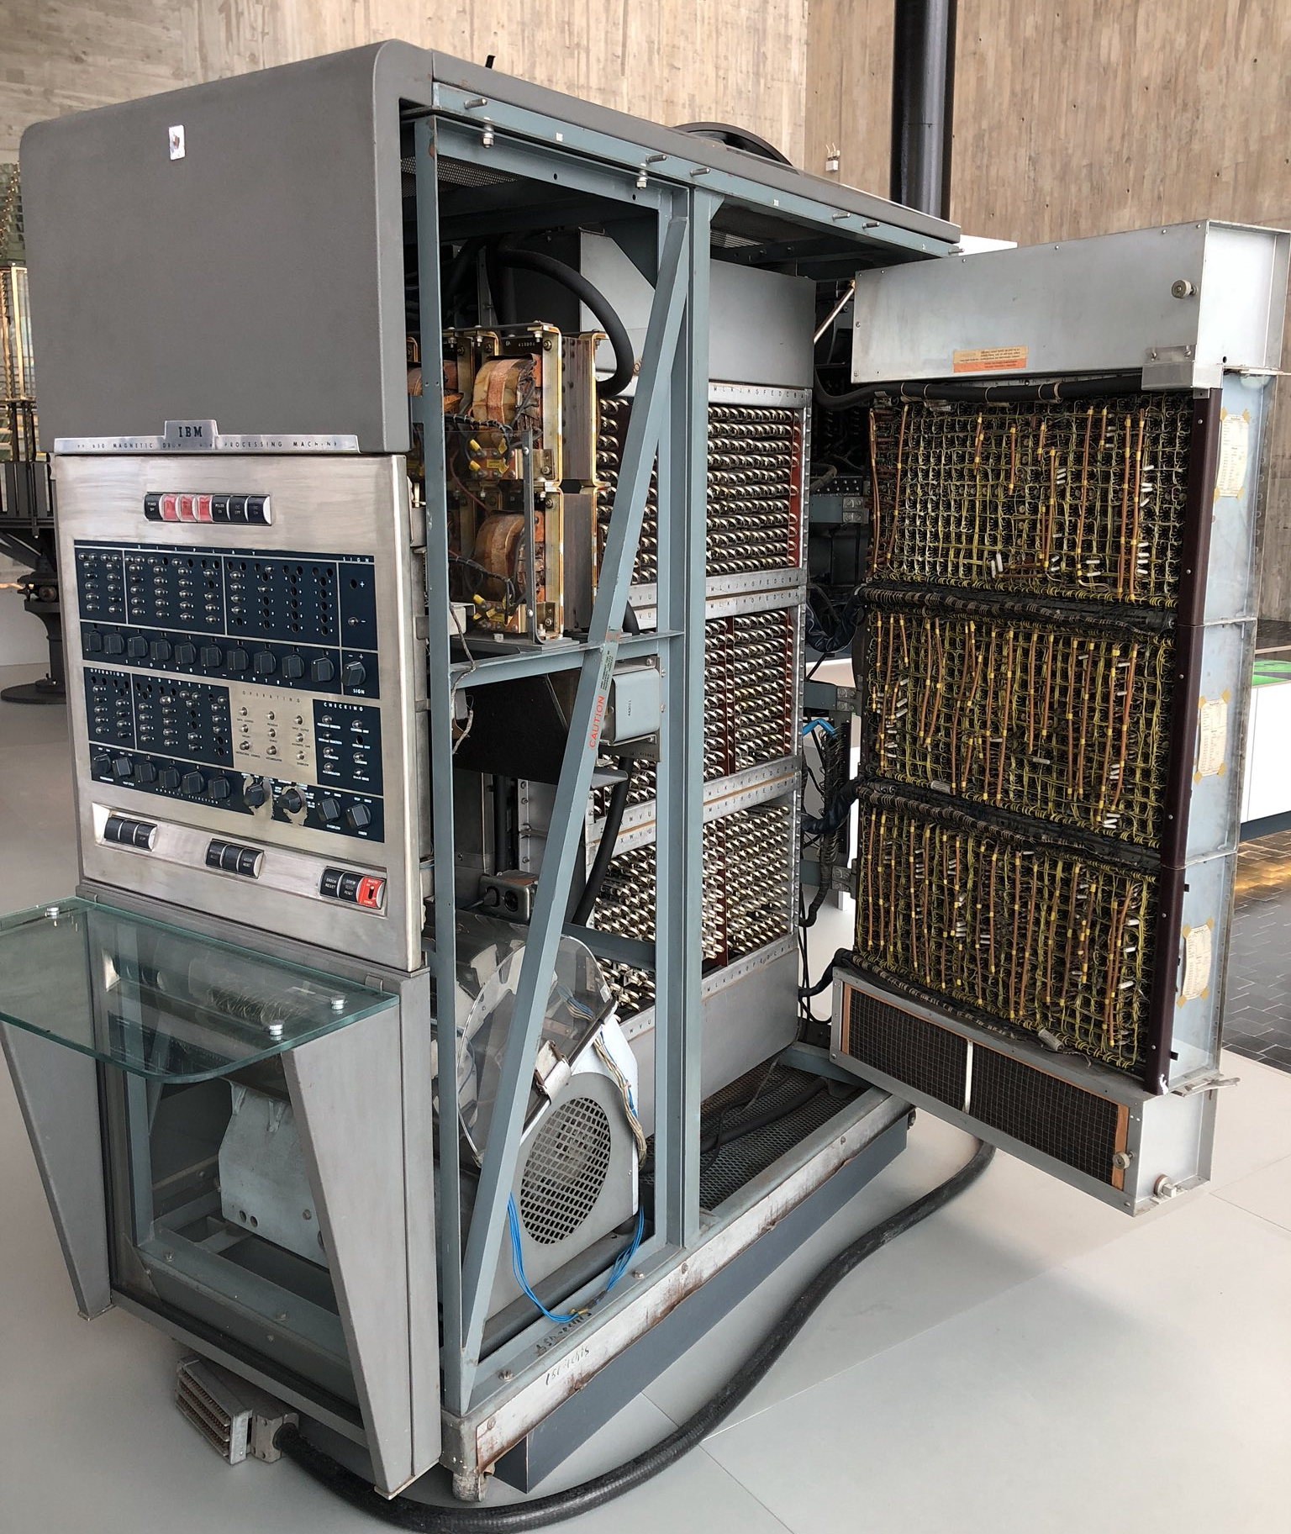
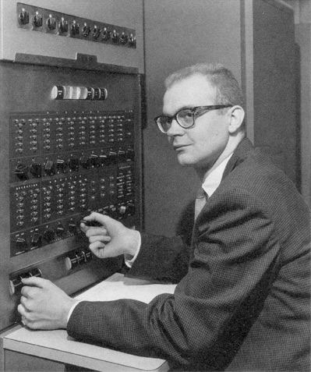
Mainframe Computing
IBM 650 - 1953
Donald Knuth
Notes:
2000 tubes, bcd arithmetic, magnetic drum

Slide 15
What were mainframe computers used for?
Notes:
Costs and benefits, addressing unmet or partially met higher-level requirements
Quantum computing is an interesting idea, but no cheap qubit storage and retrieval yet

Slide 16
What were mainframe computers used for?
Everything!
Business Accounting
Inventory
Manufacturing
Payroll
Banking Reservations and Ticketing
Database Storage and Retrieval
Scientific Computing
Notes:
Costs and benefits, addressing unmet or partially met higher-level requirements
Quantum computing is an interesting idea, but no cheap qubit storage and retrieval yet

Slide 17
Change Vectors
Applications
Middleware
Operating Systems
Computers
Processors
Memories
Display Components
Interconnects
Materials
Physics
Notes:
Middleware is anything that’s not an app or an OS ==> languages, databases, frameworks, etc.

Slide 18
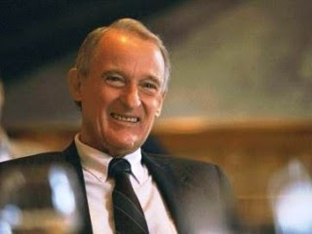
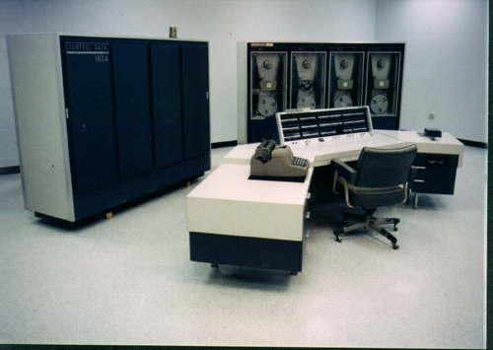
Transistors – what a concept!
CDC 1604 - 1959
Seymour Cray
- ~100 Kips
- $995K ($10.7M in 2024 dollars)
- 20+ produced
Notes:
2000 tubes, bcd arithmetic, magnetic drum

Slide 19
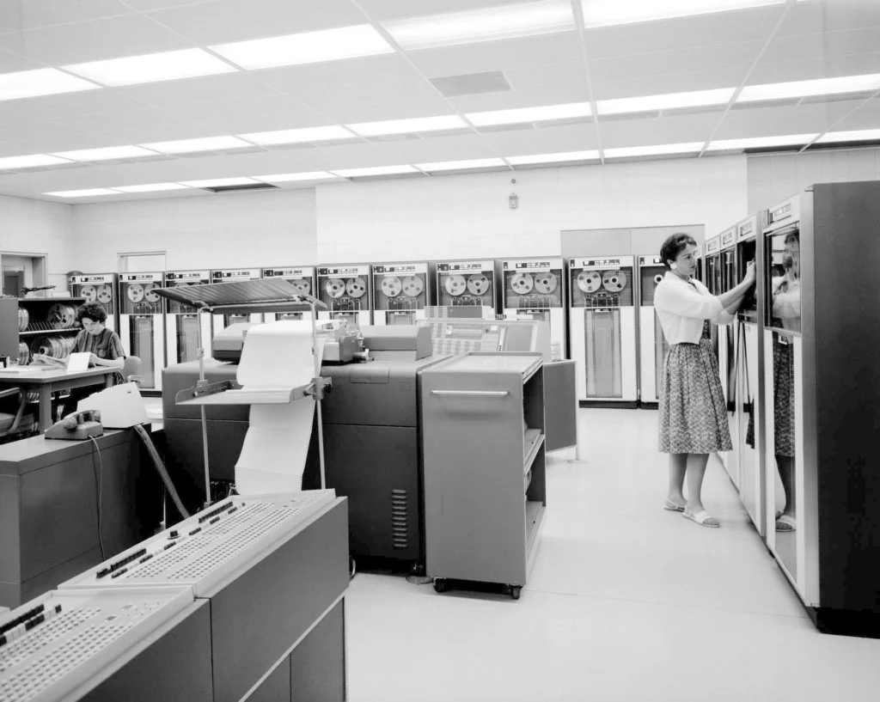
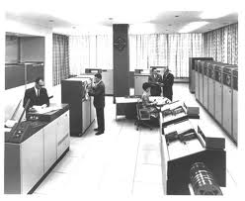
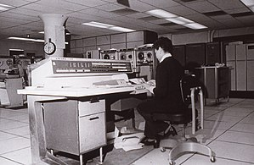
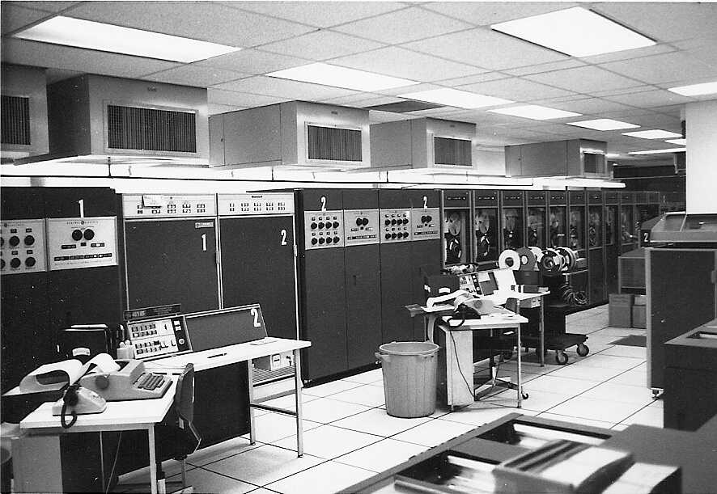
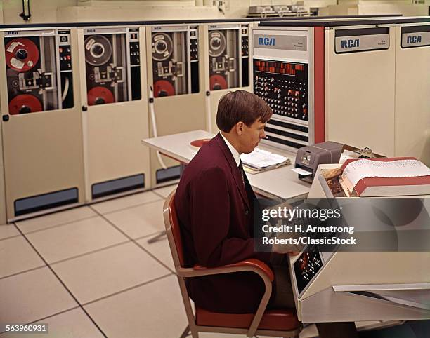
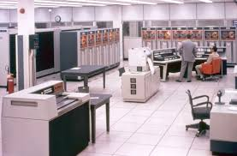
Mainframe Computing – an Incompatible Mess
IBM
Burroughs
Univac
General Electric
RCA
Control Data
Notes:
2000 tubes, bcd arithmetic, magnetic drum

Slide 20
IBM – and the Seven Dwarfs: 1950 - 1972
IBM
Burroughs General Electric
Univac
NCR
Control Data
Honeywell
RCA
Notes:
Costs and benefits, addressing unmet or partially met higher-level requirements
Quantum computing is an interesting idea, but no cheap qubit storage and retrieval yet

Slide 21
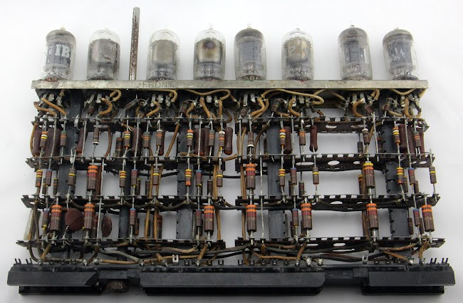
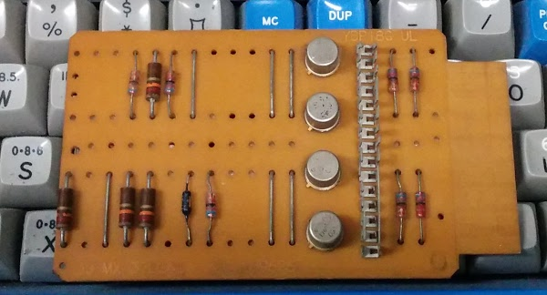
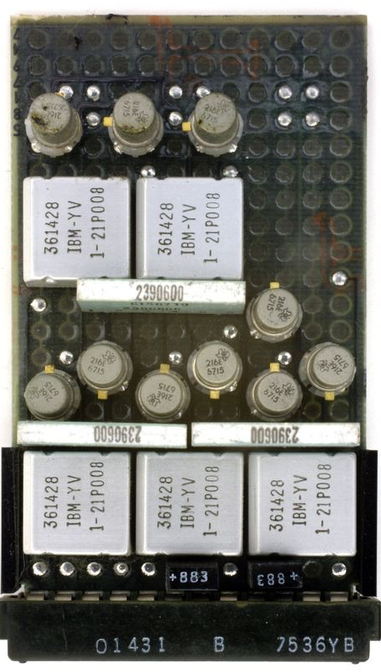
Mainframe Components – 1st to 3rd Generation
Notes:
2000 tubes, bcd arithmetic, magnetic drum

Slide 22
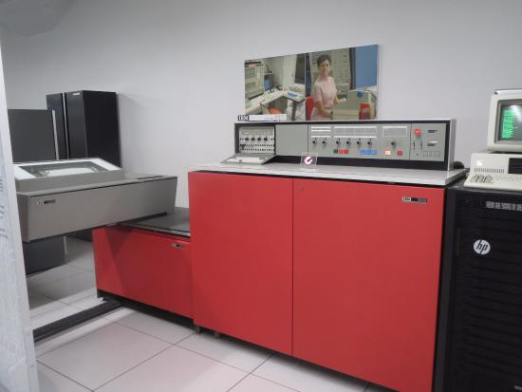
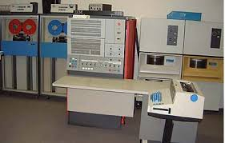
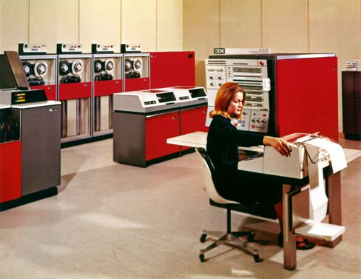
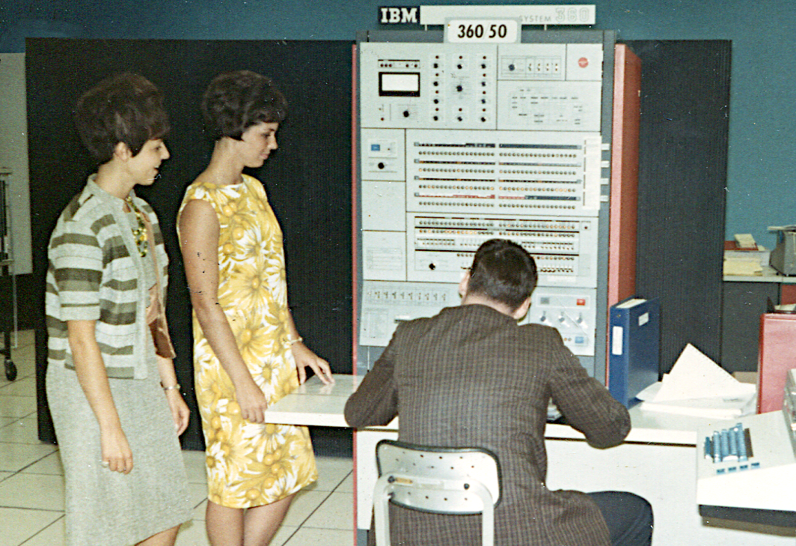
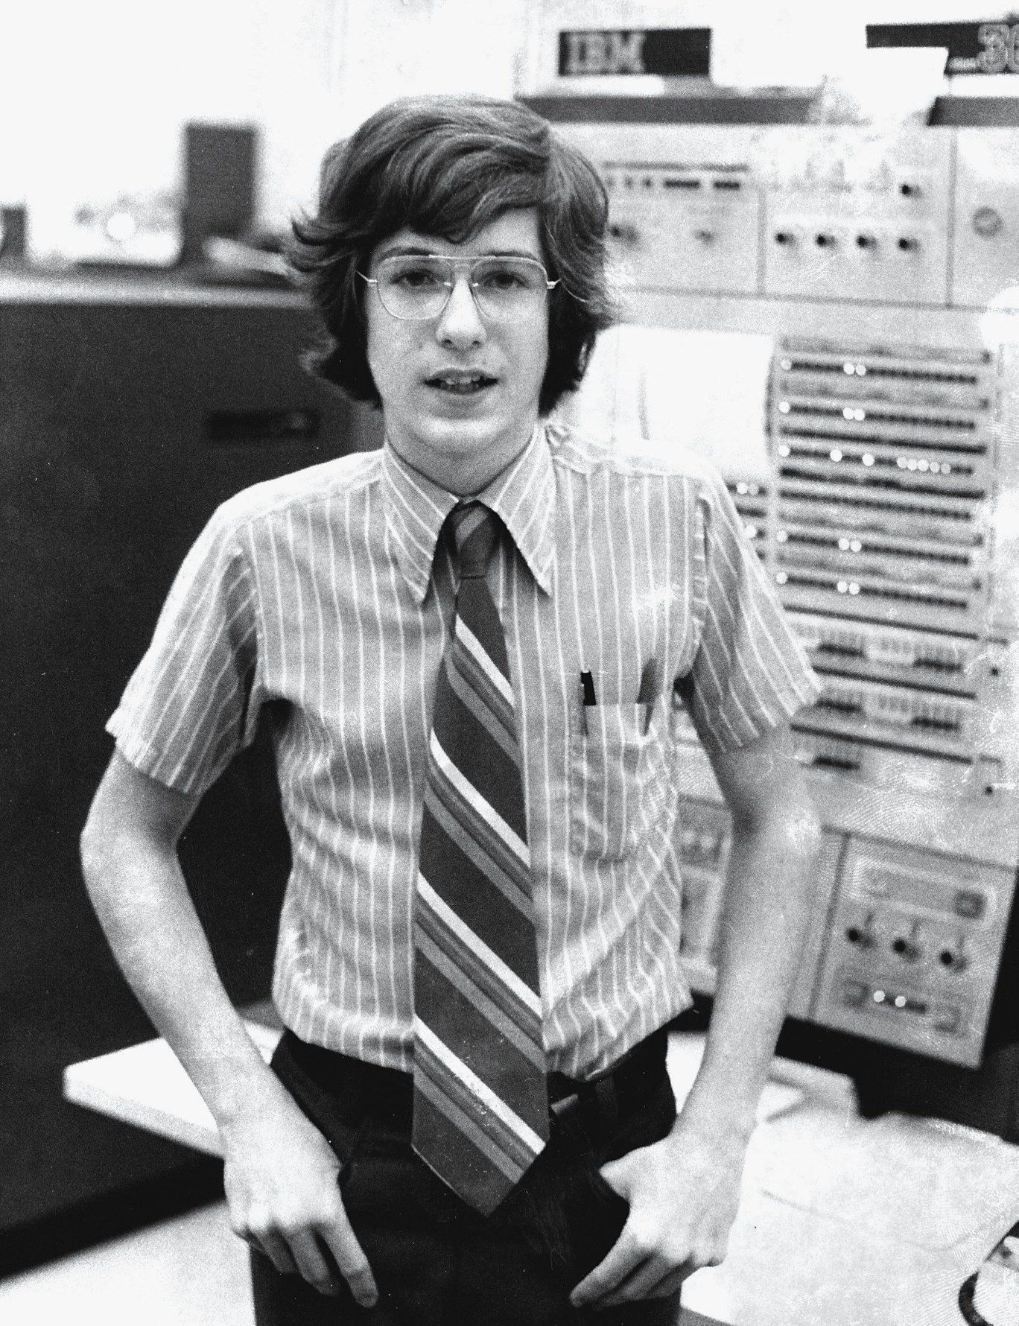
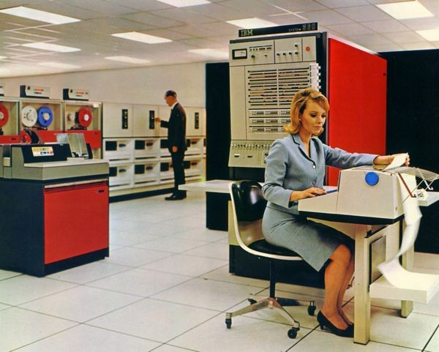
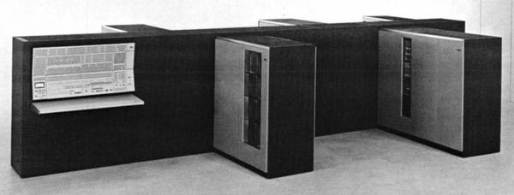
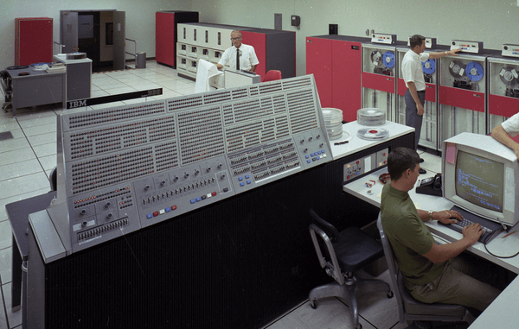
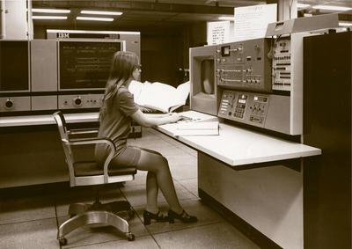
Mainframe Computing – 1964 - 1970: IBM 360
Computing “family” : 10+ models
- ~17 Mips
- $12M ($103M)
- ~20 produced
- ~5.7 Kips
- $63K ($641K)
- 7,400 produced
Notes:
2000 tubes, bcd arithmetic, magnetic drum

Slide 23
Mainframe Computing – 1964 - 1970: IBM 360
Computing “family” : 10+ models
Notes:
2000 tubes, bcd arithmetic, magnetic drum

Slide 24
Mainframe Computing – 1964 - 1970: IBM 360
Computing “family” : 10+ models
Brown University IBM 360/67 – 1972
1 – 1.5MB RAM (depending on day)
Notes:
2000 tubes, bcd arithmetic, magnetic drum

Slide 25
Supercomputing – the need for speed
Initial market drivers
Nuclear weapons research
Cryptography / Codebreaking
Engineering computations Weather forecasting
Recent developments
Genomics
Computer graphics
Computational chemistry Machine learning
Notes:
2000 tubes, bcd arithmetic, magnetic drum

Slide 26
Change Vectors
Applications
Middleware
Operating Systems
Computers
Processors
Memories
Display Components
Interconnects
Materials
Physics
Notes:
Middleware is anything that’s not an app or an OS ==> languages, databases, frameworks, etc.

Slide 27
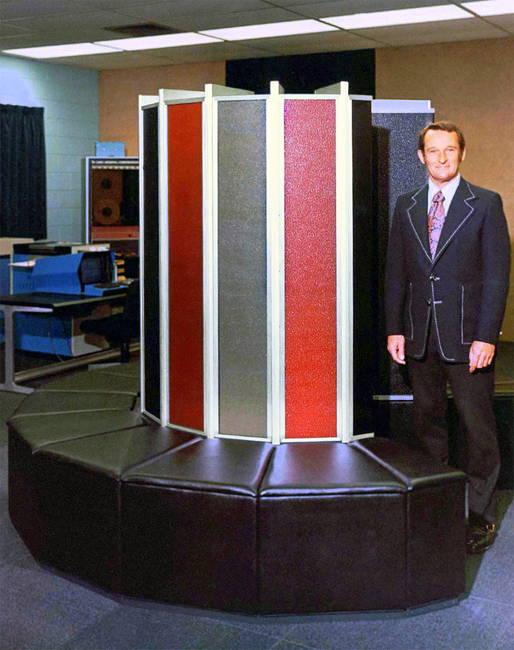
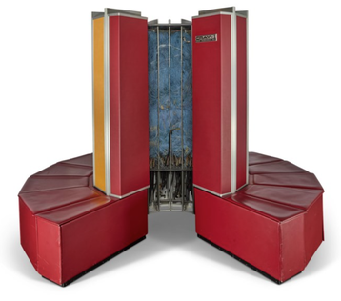
Supercomputing – more power!
Cray 1 - 1975
- $8M ($46.8M in 2024 dollars)
- 160 Mflops
- Vector processing
- Launch customer: LANL
- 80 built
Notes:
2000 tubes, bcd arithmetic, magnetic drum

Slide 28
Supercomputing – more power through SIMD
a1
b1
c1
a2
b2
c2
a3
b3
c3
a4
b4
c4
a1
a2
a3
a4
Vector A reg
A reg
B reg
b1
b2
b3
b4
Vector B reg
op
op
op
op
op
C reg
c1
c2
c3
c4
Vector C reg
Notes:
2000 tubes, bcd arithmetic, magnetic drum

Slide 29
IBM – and the BUNCH: 1972 - 1986
IBM
Burroughs Univac
NCR
Control Data
Honeywell
Notes:
Costs and benefits, addressing unmet or partially met higher-level requirements
Quantum computing is an interesting idea, but no cheap qubit storage and retrieval yet

Slide 30
Change Vectors
Applications
Middleware
Operating Systems
Computers
Processors
Memories
Display Components
Interconnects
Materials
Physics
Notes:
Middleware is anything that’s not an app or an OS ==> languages, databases, frameworks, etc.

Slide 31
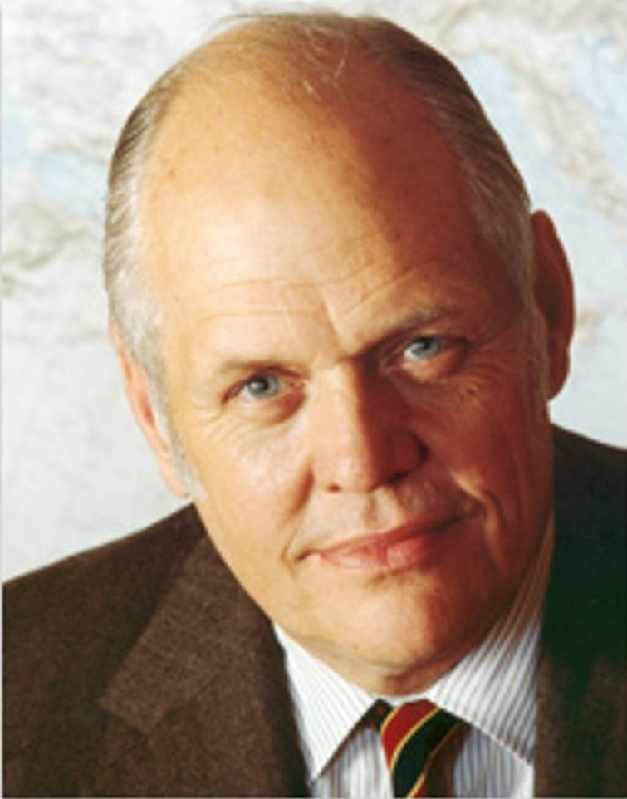
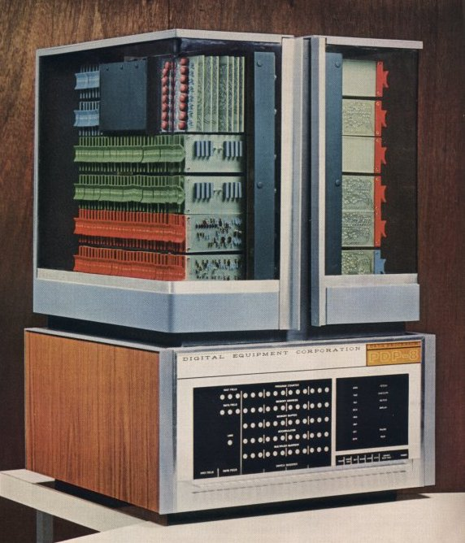
Minicomputers – let’s get small
DEC PDP-8 1964
Ken Olsen
- 385 Kips
- $18.5K ($185K in 2024 dollars)
- 50,000+ sold (various models)
Notes:
2000 tubes, bcd arithmetic, magnetic drum

Slide 32
The Wheel of Reincarnation
Applications
Middleware
Operating Systems
Computers
Processors | Memories | Display Components | Interconnects
Materials
Physics
Notes:
Fed from developments in lowest and highest levels
Even if you don’t remember the past, you are condemned to repeat it…
What is the cycle time?

Slide 33
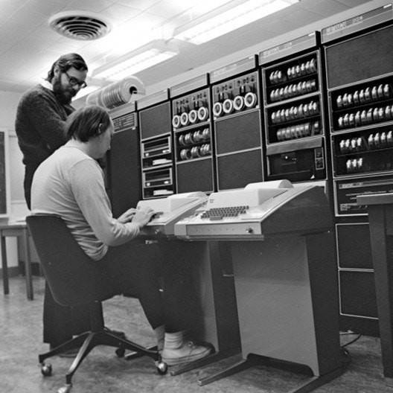
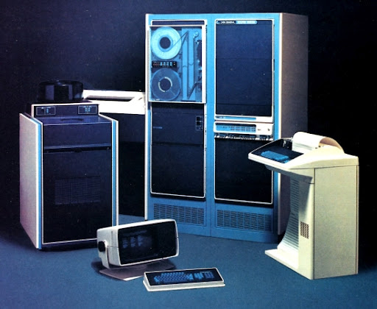
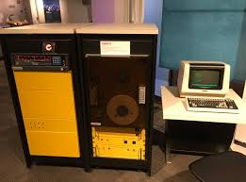
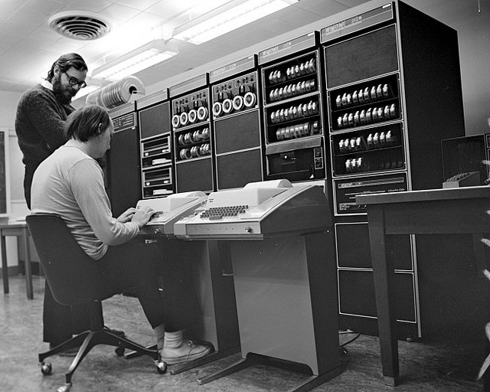
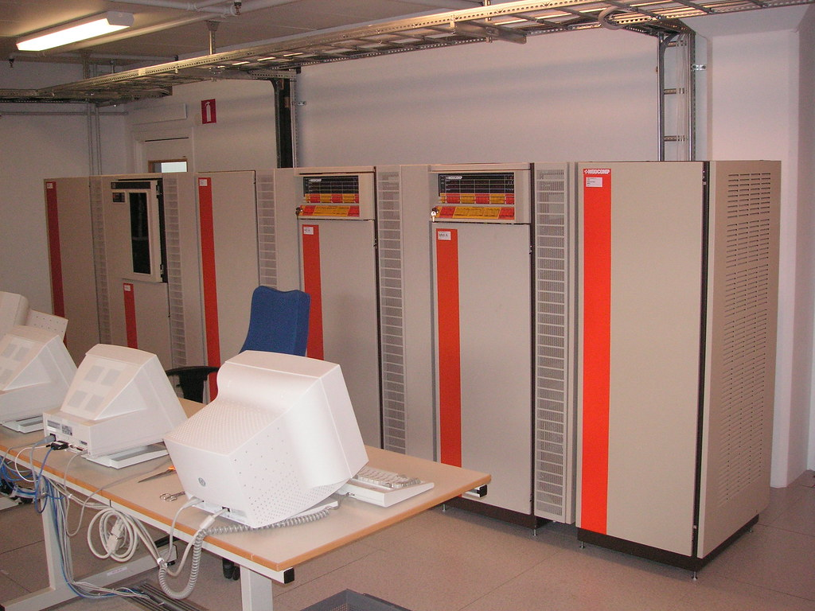
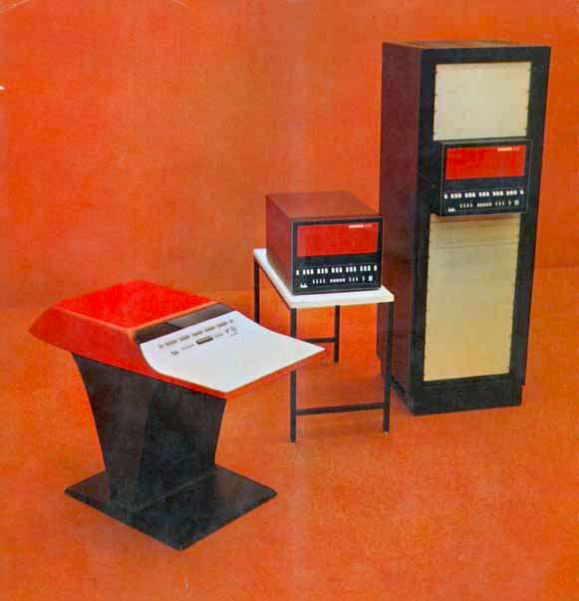
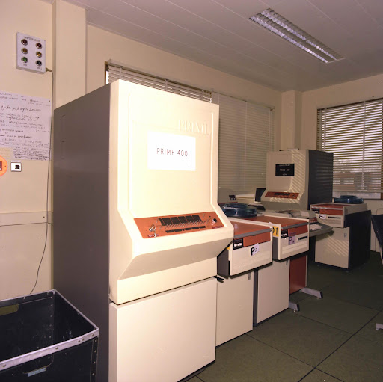
Minicomputing – an Incompatible Mess
DEC
Data General
Interdata
Ken Thompson
Dennis Ritchie
Modcomp
Honeywell
Prime
Notes:
2000 tubes, bcd arithmetic, magnetic drum

Slide 34
Minicomputers were/weren’t great
- Expanded access to computing
- Reduced mainframe usage bottlenecks - Accelerated development of computing networks and distributed computing
- Created IT management headaches - Reinvented many wheels
Notes:
Costs and benefits, addressing unmet or partially met higher-level requirements
Quantum computing is an interesting idea, but no cheap qubit storage and retrieval yet

Slide 35
The Wheel of Reincarnation
Applications
Middleware
Operating Systems
Computers
Processors | Memories | Display Components | Interconnects
Materials
Physics
Notes:
Fed from developments in lowest and highest levels
Even if you don’t remember the past, you are condemned to repeat it…
What is the cycle time?

Slide 36
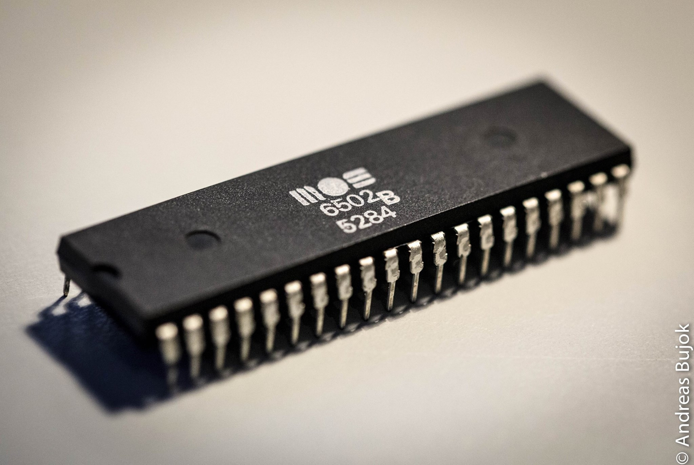
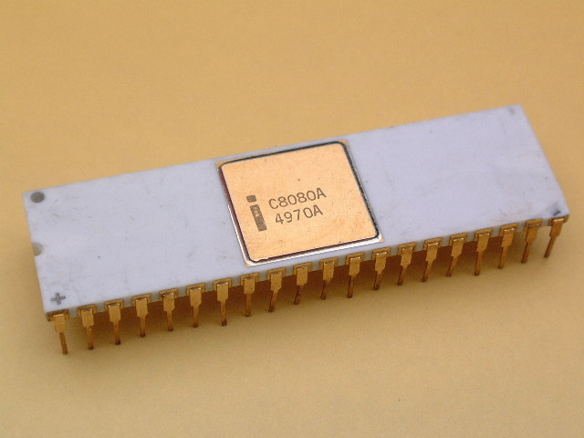
Microprocessors – let’s get even smaller
MOS Technology 6502 - 1975
Intel 8080 -1974
Notes:
2000 tubes, bcd arithmetic, magnetic drum

Slide 37
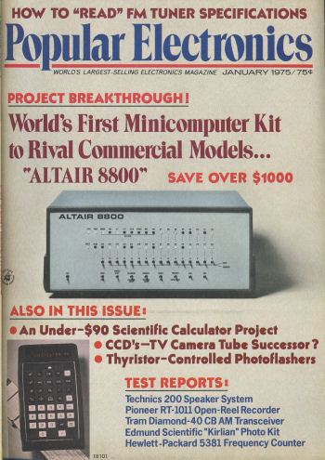
Notes:
2000 tubes, bcd arithmetic, magnetic drum

Slide 38
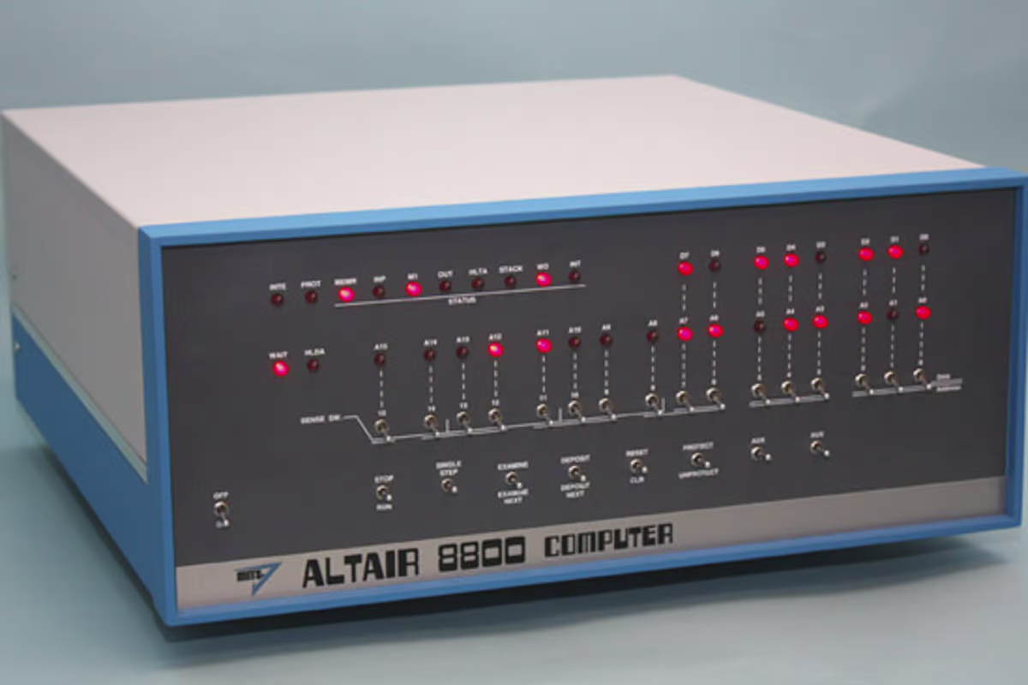
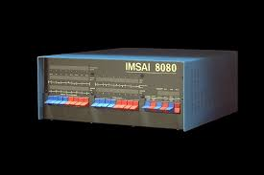
Microcomputing – an incompatible mess
1974
1975
- ~290 Kips
- $621 ($3.9K in 2024 dollars) - $439 kit
- 25,000+ sold
- ~290 Kips
- $931 ($5.5K in 2024 dollars) - $599 kit
- 20,000+ sold
Notes:
2000 tubes, bcd arithmetic, magnetic drum

Slide 39
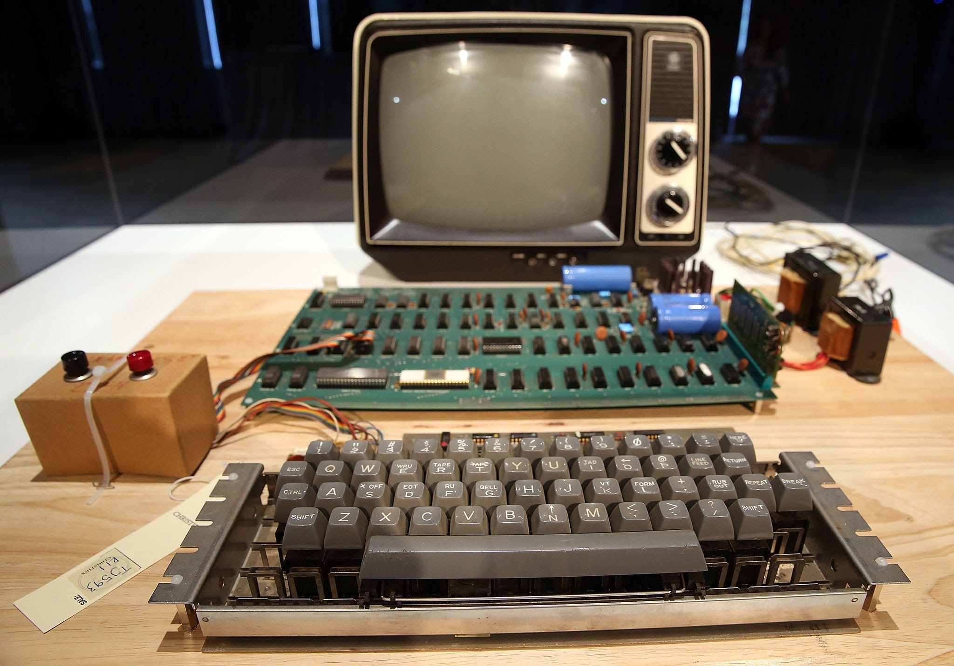
Microcomputing – an incompatible mess
Apple I - 1976
- ~400 Kips
- $666.66 ($3.7K in 2024 dollars) - 200 made, many returned
Notes:
2000 tubes, bcd arithmetic, magnetic drum

Slide 40
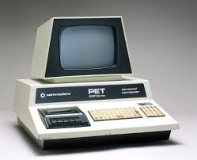
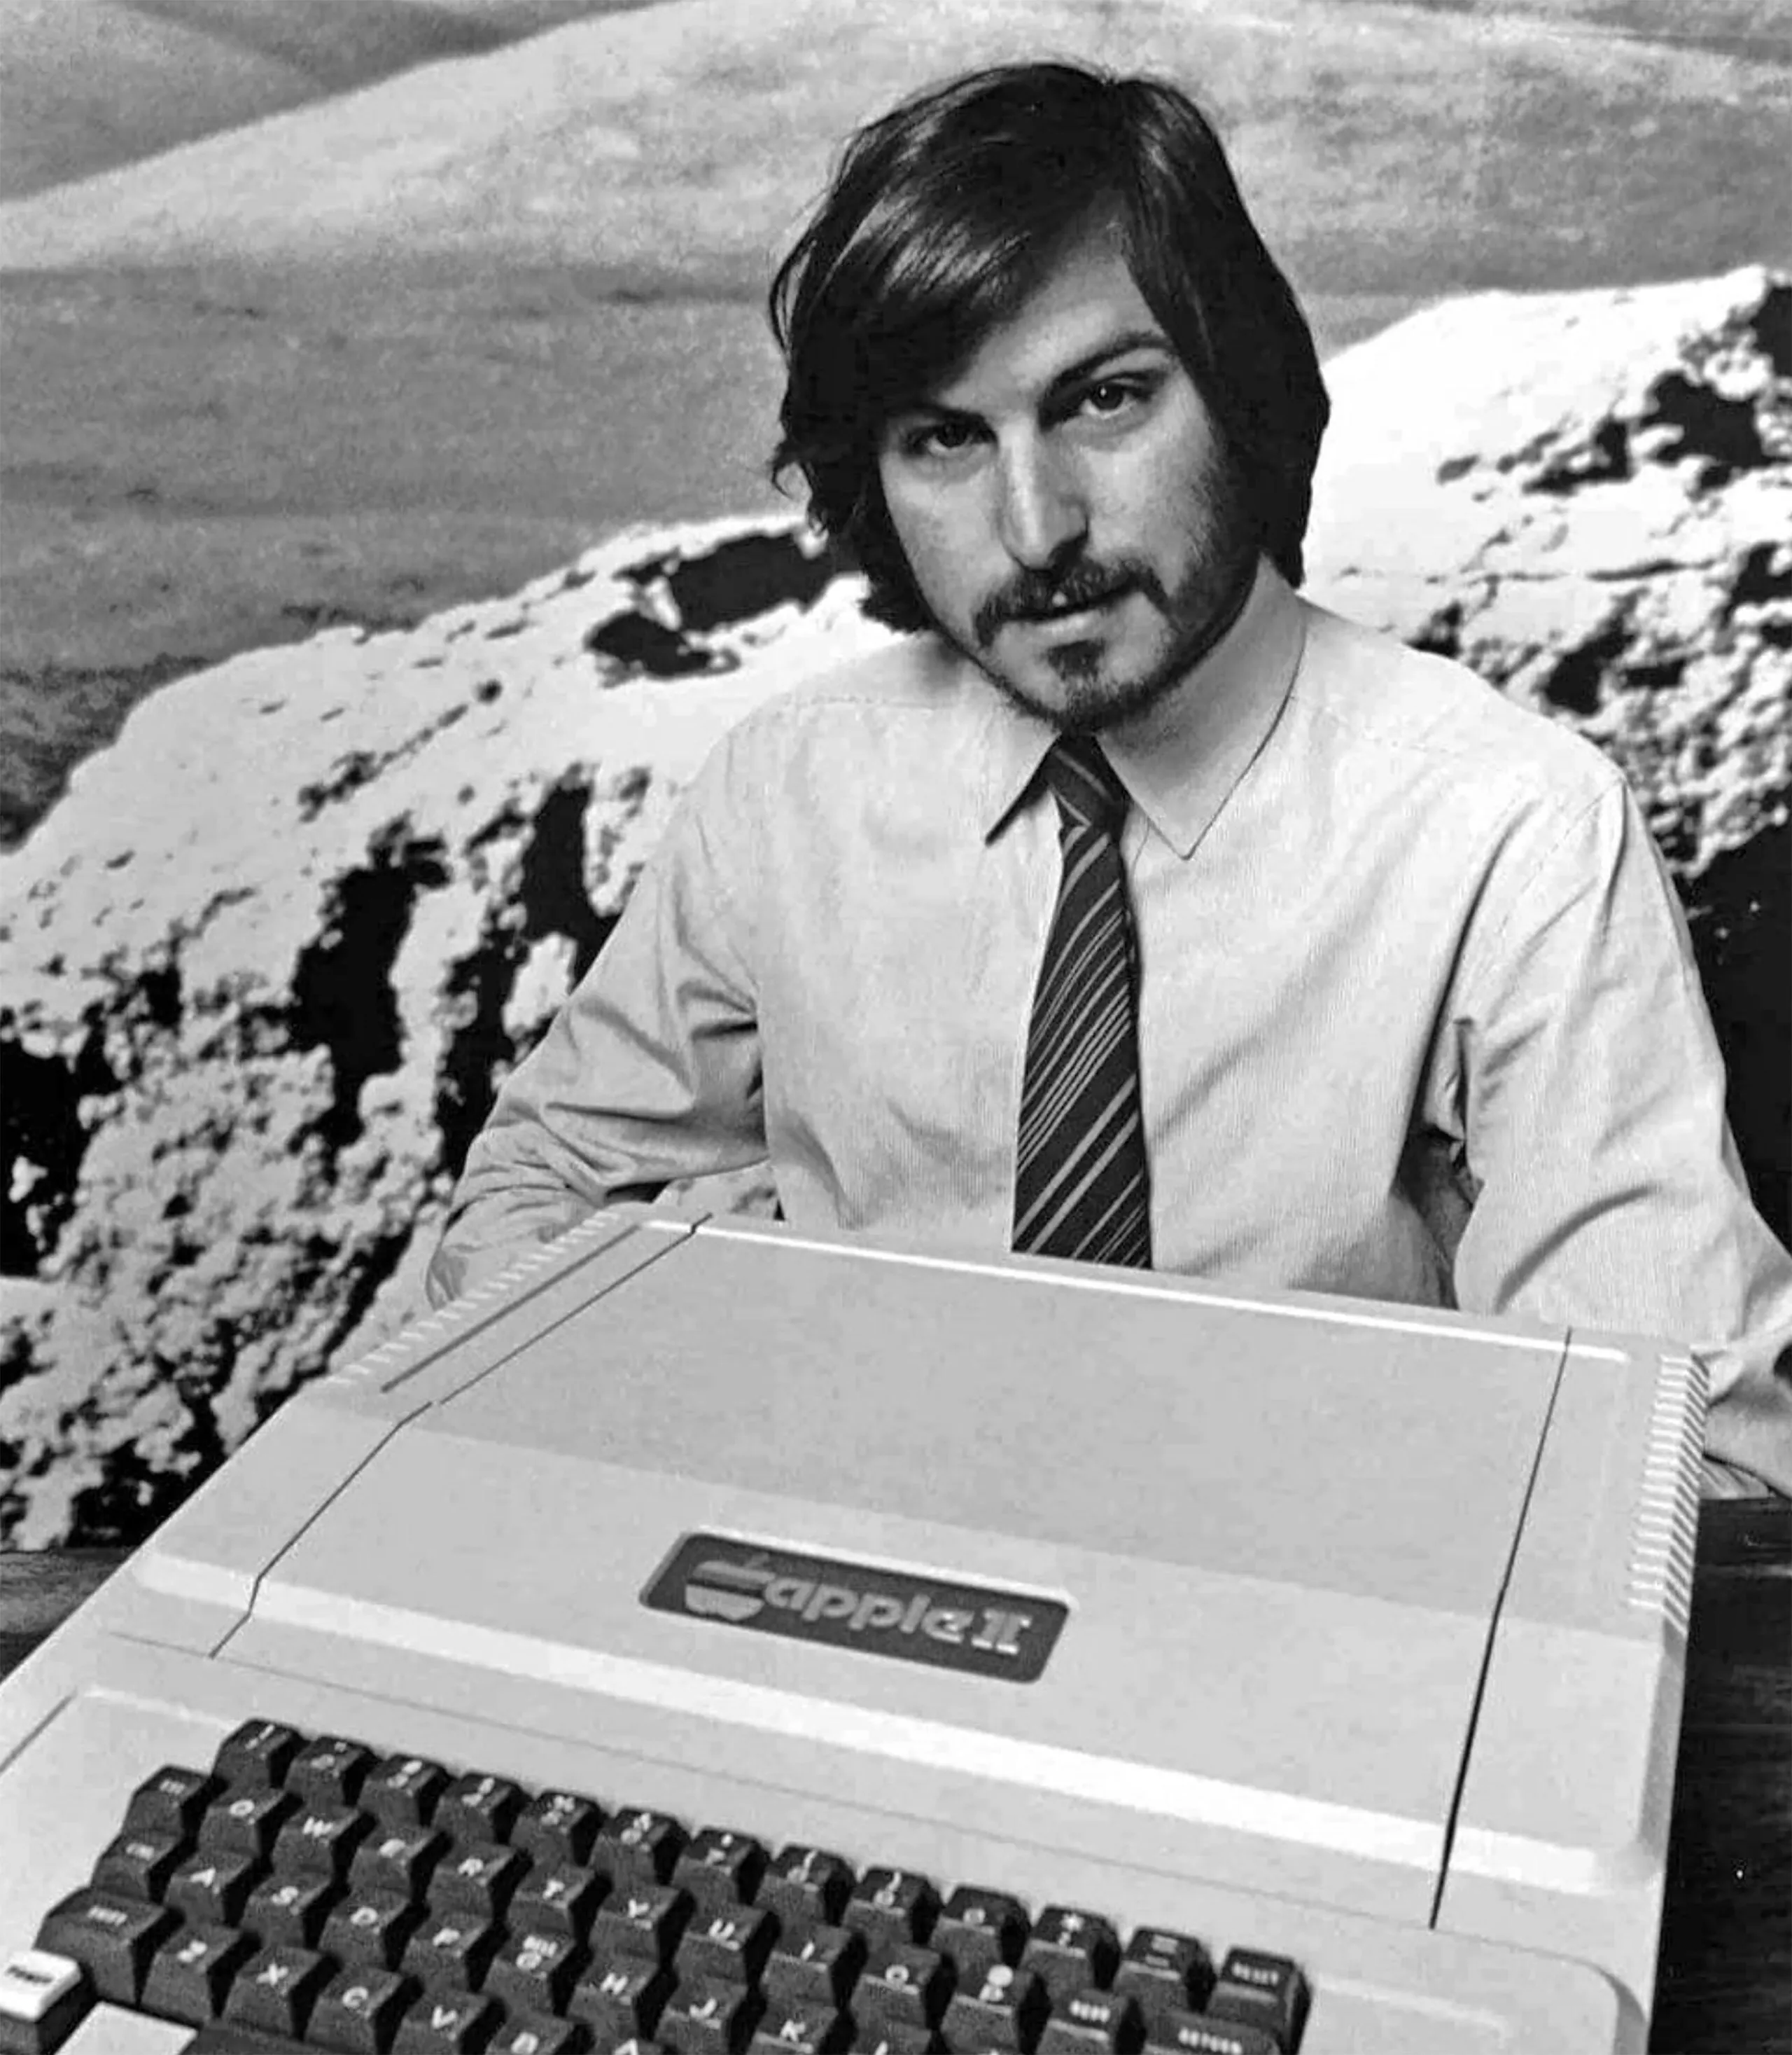
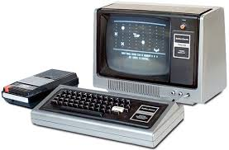
Microcomputing – an incompatible mess, 1977
Commodore PET
Apple II
Radio Shack TRS-80
- ~400 Kips
- $795 ($4.1K) - 219,000 sold
- ~400 Kips
- $1,298 ($6.7K) - ~6M sold (all models)
- ~300 Kips
- $599.95 ($3.1K) - 2.4M sold (all models)
Notes:
2000 tubes, bcd arithmetic, magnetic drum

Slide 41
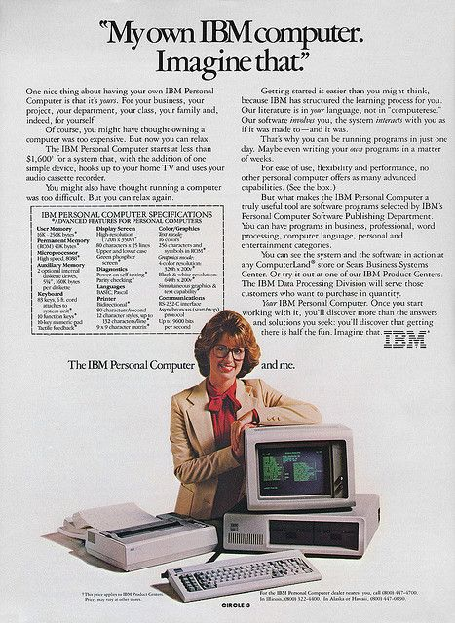
Microcomputing – the giant awakens, 1981
- ~300 Kips
- $1,565 ($5.4K) - 500,000+ sold in 1st 2 years
Notes:
2000 tubes, bcd arithmetic, magnetic drum

Slide 42

Microcomputing – the clone wars
COMPAQ portable - 1982
- ~300 Kips
- $2,995 ($9.8K) - 53,000 sold in 1st year, $111M revenue (1983 $329M, 1984 $504M)
Notes:
2000 tubes, bcd arithmetic, magnetic drum

Slide 43
Microcomputing – the clone wars
1980: ~24 companies
724,000 units sold
1982: 100+ companies
2,800,000 units sold
Microsoft was a huge beneficiary
Notes:
2000 tubes, bcd arithmetic, magnetic drum

Slide 44
Microcomputing – mission accomplished
Worldwide PC population now exceeds 2.7B units
Notes:
2000 tubes, bcd arithmetic, magnetic drum

Slide 45


Microcomputing – Apple tries something different
Apple Macintosh - 1984
Notes:
2000 tubes, bcd arithmetic, magnetic drum

Slide 46


…but not really
Xerox Alto - 1972
Vannevar Bush - 1945
Xerox Star - 1981
Douglas Englebart - 1968
Notes:
2000 tubes, bcd arithmetic, magnetic drum

Slide 47
‘Beleaguered’ Apple - 1997
“I’d shut it down and give the money back to the shareholders”
- Michael Dell
Notes:
2000 tubes, bcd arithmetic, magnetic drum

Slide 48





Apple - renaissance
1997
1998
2007
2001
Notes:
2000 tubes, bcd arithmetic, magnetic drum

Slide 49

Current status: mainframes
IBM z16 - 2022
- 225K+ transactions/sec peak
- $250k – $4M
- AI ‘infusion’
Still alive and working
in back rooms where
you can’t see them…
Notes:
2000 tubes, bcd arithmetic, magnetic drum

Slide 50

Current status: minicomputers
Almost entirely replaced by large PCs and PC clusters
Notes:
2000 tubes, bcd arithmetic, magnetic drum

Slide 51

Current status : supercomputing – more power through clustering
HPE Cray FRONTIER - 2023
- $600M
- 1.1 Exaflops (1B Mflops)
- Customer: ORNL
Notes:
2000 tubes, bcd arithmetic, magnetic drum

Slide 52
Current status: micro (personal) computers
- Laptops replacing desktops
- Market maturing, yearly unit volumes down
- For many consumers the phone is the computer
2.3B iPhones
3.3B Android phones
Notes:
2000 tubes, bcd arithmetic, magnetic drum

Slide 53
What’s next?
Applications
Middleware
Operating Systems
Computers
Processors | Memories | Display Components | Interconnects
Materials
Physics
Notes:
Fed from developments in lowest and highest levels
Even if you don’t remember the past, you are condemned to repeat it…
What is the cycle time?

Slide 54


Molecular computing
Notes:
2000 tubes, bcd arithmetic, magnetic drum

Slide 55


Quantum computing – when is a bit not a bit?
Notes:
2000 tubes, bcd arithmetic, magnetic drum

Slide 56
Questions & Comments

